Slide 1
Temporal Probabilistic Models

Slide 2
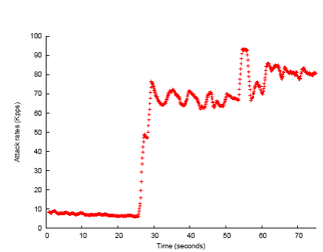
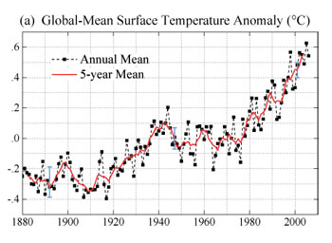
Motivation
Observing a stream of data
Monitoring (of people, computer systems, etc)
Surveillance, tracking
Finance & economics
Science
Questions:
Modeling & forecasting
Unobserved variables

Slide 3
Agenda
Markov models
Hidden Markov Models
Four HMM inference tasks
Most often used:
Filtering
Most likely explanation
Applications to NLP

Slide 4
Time Series Modeling
Time occurs in steps t=0,1,2,…
Time step can be seconds, days, years, etc
State variable X_{t}, t=0,1,2,…
For partially observed problems, we see observations O_{t}, t=1,2,… and do not see the X’s
X’s are hidden variables (aka latent variables)

Slide 5
Modeling Time
Arrow of time
Causality? Bayesian networks to the rescue
Causes
Effects

Slide 6
Probabilistic Modeling
For now, assume fully observable case
What parents?
X₀
X₁
X₂
X₃
X₀
X₁
X₂
X₃

Slide 7
Ex: Probabilistic state machine
p₃₃
p₄₄
p₁₁
Random variable
X_{t}: state at time t
Val(X_{t})={1,…,n}
P(X_{t+1}=i|X_{t}=j) = p_{ij} :
Transition model
x₁
p₁₂
x₂
p₂₃
x₃
p₃₄
x₄
p₁₅
p₅₃
p₂₆
p₄₆
x₅
p₆₅
x₆
p₅₇
p₂₇
p₈₈
p₇₅
x₇
x₈
p₇₈

Slide 8
Markov Assumption
Assume X_{t+k} is independent of all X_{i} for i<t P(X_{t+k} | X₀,…,X_{t+k-1}) = P(X_{t+k} | X_{t},…,X_{t+k-1})
K-th order Markov Chain
Order 0
X₀
X₁
X₂
X₃
Order 1
X₀
X₁
X₂
X₃
Order 2
X₀
X₁
X₂
X₃
Order 3
X₀
X₁
X₂
X₃

Slide 9
1st order Markov Chain
MC’s of order k>1 can be converted into a 1st order MC [left as exercise]
So w.o.l.o.g., “MC” refers to a 1st order MC
X₀
X₁
X₂
X₃

Slide 10
Inference in MC
What independence relationships can we read from the BN?
X₀
X₁
X₂
X₃
Observe X₁
X₀ independent of X₂, X₃, …
P(X_{t}|X_{t-1}) known as transition model

Slide 11
Inference in MC
Prediction: the probability of future state?
P(X_{t}) = Σ_{x0,…,xt-1}P (X₀,…,X_{t}) = Σ_{x0,…,xt-1}P (X₀) Π_{x1,…,xt} P(X_{i}|X_{i-1}) = Σ_{xt-1}P(X_{t}|X_{t-1}) P(X_{t-1})
“Blurs” over time, and approaches stationary distribution as t grows
Limited prediction power
Rate of blurring known as mixing time
[Incremental approach]

Slide 12
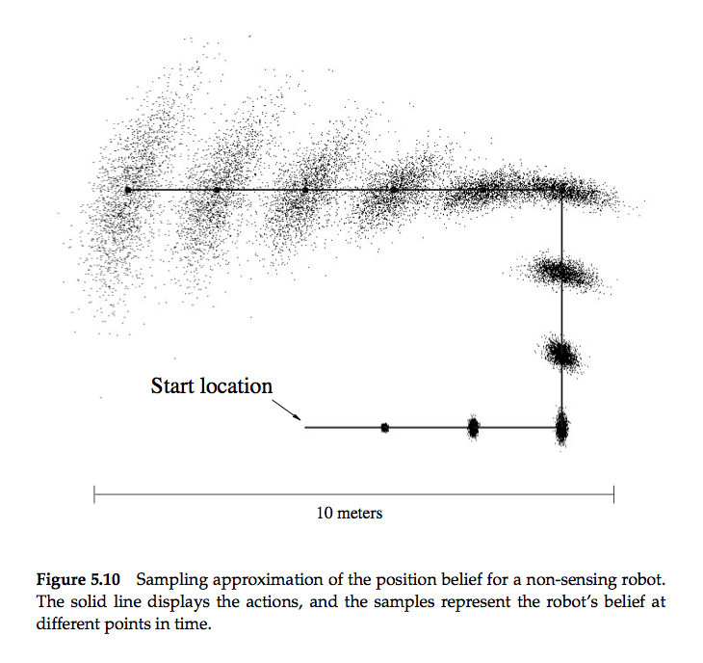

Slide 13
How does the Markov assumption affect the choice of state?
Suppose we’re tracking a point (x,y) in 2D
What if the point is…
A momentumless particle subject to thermal vibration?
A particle with velocity?
A particle with intent, like a person?

Slide 14
How does the Markov assumption affect the choice of state?
Suppose the point is the position of our robot, and we observe velocity and intent
What if:
Terrain conditions affect speed?
Battery level affects speed?
Position is noisy, e.g. GPS?

Slide 15

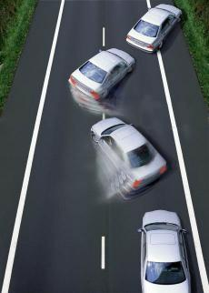

Is the Markov assumption appropriate for:
A car on a slippery road?
Sales of toothpaste?
The stock market?

Slide 16
History Dependence
In Markov models, the state must be chosen so that the future is independent of history given the current state
Often this requires adding variables that cannot be directly observed

Slide 17
Partial Observability
Hidden Markov Model (HMM)
X₀
X₁
X₂
X₃
Hidden state variables
O₁
O₂
O₃
Observed variables
P(O_{t}|X_{t}) called the observation model (or sensor model)

Slide 18
Inference in HMMs
Filtering
Prediction
Smoothing, aka hindsight
Most likely explanation
X₀
X₁
X₂
X₃
O₁
O₂
O₃

Slide 19
Inference in HMMs
Filtering
Prediction
Smoothing, aka hindsight
Most likely explanation
Query variable
X₀
X₁
X₂
O₁
O₂

Slide 20
Filtering
Name comes from signal processing
P(X_{t}|o_{1:t}) = Σ_{xt-1} P(x_{t-1}|o_{1:t-1}) P(X_{t}|x_{t-1},o_{t})
P(X_{t}|X_{t-1},o_{t}) = P(o_{t}|X_{t-1},X_{t})P(X_{t}|X_{t-1})/P(o_{t}|X_{t-1}) = α P(o_{t}|X_{t})P(X_{t}|X_{t-1})
Query variable
X₀
X₁
X₂
O₁
O₂

Slide 21
Filtering
P(X_{t}|o_{1:t}) = α Σ_{xt-1}P(x_{t-1}|o_{1:t-1}) P(o_{t}|X_{t})P(X_{t}|x_{t-1})
Forward recursion
If we keep track of P(X_{t}|o_{1:t}) => O(1) updates for all t!
Query variable
X₀
X₁
X₂
O₁
O₂

Slide 22
Inference in HMMs
Filtering
Prediction
Smoothing, aka hindsight
Most likely explanation
Query
X₀
X₁
X₂
X₃
O₁
O₂
O₃

Slide 23
Prediction
P(X_{t+k}|o_{1:t})
2 steps: P(X_{t}|o_{1:t}), then P(X_{t+k}|X_{t})
Filter then predict as with standard MC
Query
X₀
X₁
X₂
X₃
O₁
O₂
O₃

Slide 24
Inference in HMMs
Filtering
Prediction
Smoothing, aka hindsight
Most likely explanation
Query
X₀
X₁
X₂
X₃
O₁
O₂
O₃

Slide 25
Smoothing
P(X_{k}|o_{1:t}) for k < t
P(X_{k}|o_{1:k},o_{k+1:t}) = P(o_{k+1:t}|X_{k},o_{1:k})P(X_{k}|o_{1:k})/P(o_{k+1:t}|o_{1:k}) = α P(o_{k+1:t}|X_{k})P(X_{k}|o_{1:k})
Standard filtering to time k
Query
X₀
X₁
X₂
X₃
O₁
O₂
O₃

Slide 26
Smoothing
Computing P(o_{k+1:t}|X_{k})
P(o_{k+1:t}|X_{k}) = Σ_{xk+1}P(o_{k+1:t}|X_{k},x_{k+1}) P(x_{k+1}|X_{k}) = Σ_{xk+1}P(o_{k+1:t}|x_{k+1}) P(x_{k+1}|X_{k}) = Σ_{xk+1}P(o_{k+2:t}|x_{k+1})P(o_{k+1}|x_{k+1})P(x_{k+1}|X_{k})
Backward recursion
Given prior states
X₀
X₁
X₂
X₃
What’s the probability of this sequence?
O₁
O₂
O₃

Slide 27
Inference in HMMs
Filtering
Prediction
Smoothing, aka hindsight
Most likely explanation
Query returns a path through state space x0,…,x3
X₀
X₁
X₂
X₃
O₁
O₂
O₃

Slide 28
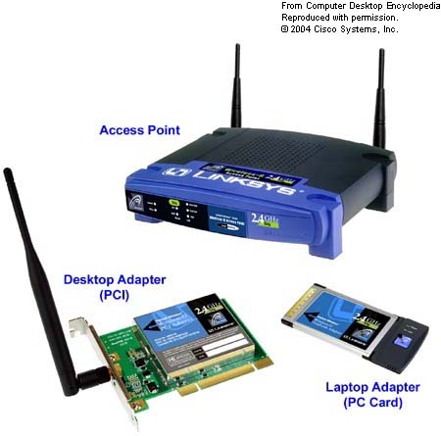
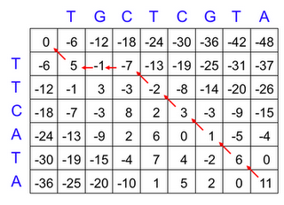

Most Likely Explanation
Find: arg max _{x0,…,xt} P(x₀,…,x_{t} | o₁,…,o_{t})
The whole sequence x₀,…,x_{t} is under consideration
Many practical applications
Protein sequence alignment
Communication codes
Intelligent user interfaces

Slide 29
Viterbi Algorithm
Observation: P(x_{0:t} | o_{1:t}) = P(x_{0:t-1},x_{t} | o_{1:t}) = 1/Z P(x_{t}|x_{t-1}) P(O_{t}|x_{t}) P(x_{0:t-1} | o_{1:t-1})
If we knew what x_{t-1}* and P(x_{0:t-1}* | o_{1:t-1}) were, then we could determine x_{0:t}* by maximizing over possible assignments to x_{t}
Suggests a dynamic programming algorithm to determine this recursively

Slide 30
Viterbi Algorithm for discrete X
Store two arrays V[i,k], π[i,k]
V[i,k]: the max probability of any sequence ending in X_{i}=k
V[i,k] = max_{x[0:i-1]} P(x_{0:i-1},X_{i}=k|o_{1:i})

Slide 31
Viterbi Algorithm for discrete X
Store two arrays V[i,k], π[i,k]
V[i,k]: the max probability of any sequence ending in X_{i}=k
V[i,k] = max_{x[0:i-1]} P(x_{0:i-1},X_{i}=k|o_{1:i})
V[i,k] = max_{x[0:i-1]} P(x_{0:i-1},X_{i}=k|o_{1:i})
P(x_{0:i-1},X_{i}=k|o_{1:i}) = P(X_{i}=k|x_{i-1})P(o_{i}|X_{i}=k)P(x_{0:i-1}|o_{1:i-1})

Slide 32
Viterbi Algorithm for discrete X
Store two arrays V[i,k], π[i,k]
V[i,k]: the max probability of any sequence ending in X_{i}=k
V[i,k] = max_{x[0:i-1]} P(x_{0:i-1},X_{i}=k|o_{1:i})
V[i,k] = max_{x[0:i-1]} P(x_{0:i-1},X_{i}=k|o_{1:i})
P(x_{0:i-1},X_{i}=k|o_{1:i}) = P(X_{i}=k|x_{i-1})P(o_{i}|X_{i}=k)P(x_{0:i-1}|o_{1:i-1})
max_{x[0:i-1]} P(x_{0:i-1},X_{i}=k|o_{1:i}) = P(o[i]|X_{i}=k) max_{x[0:i-1]} P(X_{i}=k|x_{i-1}) P(x_{0:i-1}|o_{1:i-1})

Slide 33
Viterbi Algorithm for discrete X
Store two arrays V[i,k], π[i,k]
V[i,k]: the max probability of any sequence ending in X_{i}=k
V[i,k] = max_{x[0:i-1]} P(x_{0:i-1},X_{i}=k|o_{1:i})
V[i,k] = max_{x[0:i-1]} P(x_{0:i-1},X_{i}=k|o_{1:i})
P(x_{0:i-1},X_{i}=k|o_{1:i}) = P(X_{i}=k|x_{i-1})P(o_{i}|X_{i}=k)P(x_{0:i-1}|o_{1:i-1})
max_{x[0:i-1]} P(x_{0:i-1},X_{i}=k|o_{1:i}) = P(o[i]|X_{i}=k) max_{x[0:i-1]} P(X_{i}=k|x_{i-1}) P(x_{0:i-1}|o_{1:i-1}) = P(o[i]|X_{i}=k) max_{xi-1} P(X_{i}=k|x_{i-1}) max_{x[0:i-2]} P(x_{0:i-1}|o_{1:i-1})

Slide 34
Viterbi Algorithm for discrete X
Store two arrays V[i,k], π[i,k]
V[i,k]: the max probability of any sequence ending in X_{i}=k
V[i,k] = max_{x[0:i-1]} P(x_{0:i-1},X_{i}=k|o_{1:i})
V[i,k] = max_{x[0:i-1]} P(x_{0:i-1},X_{i}=k|o_{1:i})
P(x_{0:i-1},X_{i}=k|o_{1:i}) = P(X_{i}=k|x_{i-1})P(o_{i}|X_{i}=k)P(x_{0:i-1}|o_{1:i-1})
max_{x[0:i-1]} P(x_{0:i-1},X_{i}=k|o_{1:i}) = P(o[i]|X_{i}=k) max_{x[0:i-1]} P(X_{i}=k|x_{i-1}) P(x_{0:i-1}|o_{1:i-1}) = P(o[i]|X_{i}=k) max_{xi-1} P(X_{i}=k|x_{i-1}) max_{x[0:i-2]}P(x_{0:i-1}|o_{1:i-1})
max_{xi-1} P(X_{i}=k|x_{i-1})max_{x[0:i-2]} P(x_{0:i-1}|o_{1:i-1})

Slide 35
Viterbi Algorithm for discrete X
Store two arrays V[i,k], π[i,k]
V[i,k]: the max probability of any sequence ending in X_{i}=k
V[i,k] = max_{x[0:i-1]} P(x_{0:i-1},X_{i}=k|o_{1:i})
V[i,k] = max_{x[0:i-1]} P(x_{0:i-1},X_{i}=k|o_{1:i})
P(x_{0:i-1},X_{i}=k|o_{1:i}) = P(X_{i}=k|x_{i-1})P(o_{i}|X_{i}=k)P(x_{0:i-1}|o_{1:i-1})
max_{x[0:i-1]} P(x_{0:i-1},X_{i}=k|o_{1:i}) = P(o[i]|X_{i}=k) max_{x[0:i-1]} P(X_{i}=k|x_{i-1})P(x_{0:i-1}|o_{1:i-1}) = P(o[i]|X_{i}=k) max_{xi-1} P(X_{i}=k|x_{i-1}) max_{x[0:i-2]} P(x_{0:i-1}|o_{1:i-1})
max_{xi-1} P(X_{i}=k|x_{i-1}) max_{x[0:i-2]} P(x_{0:i-1}|o_{1:i-1}) = max_{xi-1} P(X_{i}=k|x_{i-1}) max_{x[0:i-2]} P(x_{0:i-2,}X_{i-1}=x_{i-1}|o_{1:i-1})

Slide 36
Viterbi Algorithm for discrete X
Store two arrays V[i,k], π[i,k]
V[i,k]: the max probability of any sequence ending in X_{i}=k
V[i,k] = max_{x[0:i-1]} P(x_{0:i-1},X_{i}=k|o_{1:i})
V[i,k] = max_{x[0:i-1]} P(x_{0:i-1},X_{i}=k|o_{1:i})
P(x_{0:i-1},X_{i}=k|o_{1:i}) = P(X_{i}=k|x_{i-1})P(o_{i}|X_{i}=k)P(x_{0:i-1}|o_{1:i-1})
max_{x[0:i-1]} P(x_{0:i-1},X_{i}=k|o_{1:i}) = P(o[i]|X_{i}=k) max_{x[0:i-1]} P(X_{i}=k|x_{i-1})P(x_{0:i-1}|o_{1:i-1}) = P(o[i]|X_{i}=k) max_{xi-1} P(X_{i}=k|x_{i-1}) max_{x[0:i-2]} P(x_{0:i-1}|o_{1:i-1})
max_{xi-1} P(X_{i}=k|x_{i-1}) max_{x[0:i-2]} P(x_{0:i-1}|o_{1:i-1}) = max_{xi-1} P(X_{i}=k|x_{i-1}) max_{x[0:i-2]} P(x_{0:i-2,}X_{i-1}=x_{i-1}|o_{1:i-1}) = max_{xi-1} P(X_{i}=k|x_{i-1}) V[i-1,x_{i-1}]

Slide 37
Viterbi Algorithm for discrete X
Store two arrays V[i,k], π[i,k]
V[i,k]: the max probability of any sequence ending in X_{i}=k
V[i,k] = max_{x[0:i-1]} P(x_{0:i-1},X_{i}=k|o_{1:i})
Recursive computation of V[t,k]:
V[0,k] ← P(x₀=k) (base case)
V[i,k] ← P(o_{i}|X_{i=k}) max_{xi-1} P(X_{i}=k|x_{i-1}) V[i-1,x_{i-1}]
Define π[i,k] to give the predecessor of X_{i}=k that resulted in the value of V[i,k] (i.e., arg max)

Slide 38
Viterbi Algorithm for Discrete X
Forward pass: calculate V[i,k] and π[i,k] from i=0 to t
V[0,k] ← P(x₀=k) (base case)
V[i,k] ← P(o_{i}|X_{i=k}) max_{xi-1} P(X_{i}=k|x_{i-1}) V[i-1,x_{i-1}]
π[i,k] ← arg max_{xi-1} P(X_{i}=k|x_{i-1}) V[i-1,x_{i-1}]
Backward pass: extract the most likely path using π
x_{t} ← arg max_{k} V[t,k]
x_{i-1} ← π[i,x_{i}]
The result x₀,…,x_{t} is the most likely explanation

Slide 39
In practice
Complexity: O( t |Val(X)|² )
Long or rare observation sequences => log-probabilities are more numerically stable

Slide 40
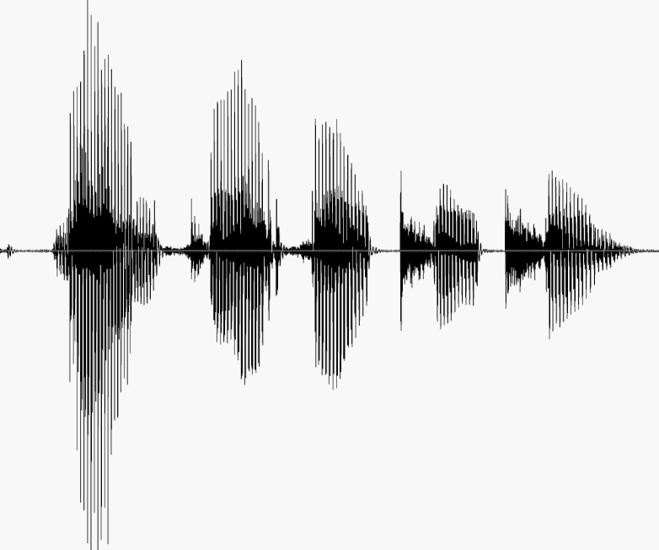
Applications of HMMs in NLP
Speech recognition
Hidden phones (e.g., ah eh ee th r)
Observed, noisy acoustic features (produced by signal processing)

Slide 41
Phone Observation Models
Phone_{t}
Model defined to be robust over variations in accent, speed, pitch, noise
Features_{t}
Signal processing
Features (24,13,3,59)

Slide 42
Phone Transition Models
Phone_{t}
Phone_{t+1}
Good models will capture (among other things):
Pronunciation of words Subphone structure
Coarticulation effects
Triphone models = order 3 Markov chain
Features_{t}

Slide 43
Word Segmentation
Words run together when pronounced
Unigrams P(w_{i})
Bigrams P(w_{i}|w_{i-1})
Trigrams P(w_{i}|w_{i-1},w_{i-2})
Random 20 word samples from R&N using N-gram models
Logical are as confusion a may right tries agent goal the was diesel more object then information-gathering search is
Planning purely diagnostic expert systems are very similar computational approach would be represented compactly using tic tac toe a predicate
Planning and scheduling are integrated the success of naïve bayes model is just a possible prior source by that time

Slide 44

Tricks to improve recognition
Narrow the # of variables
Digits, yes/no, phone tree
Training with real user data
Real story: “Yes ma’am”

Slide 45
Next Class
Continue R&N 15

